Slide 1
CSE160 – Project 0
Ashish Yadav
aayadav6@ucmerced.edu

Slide 2
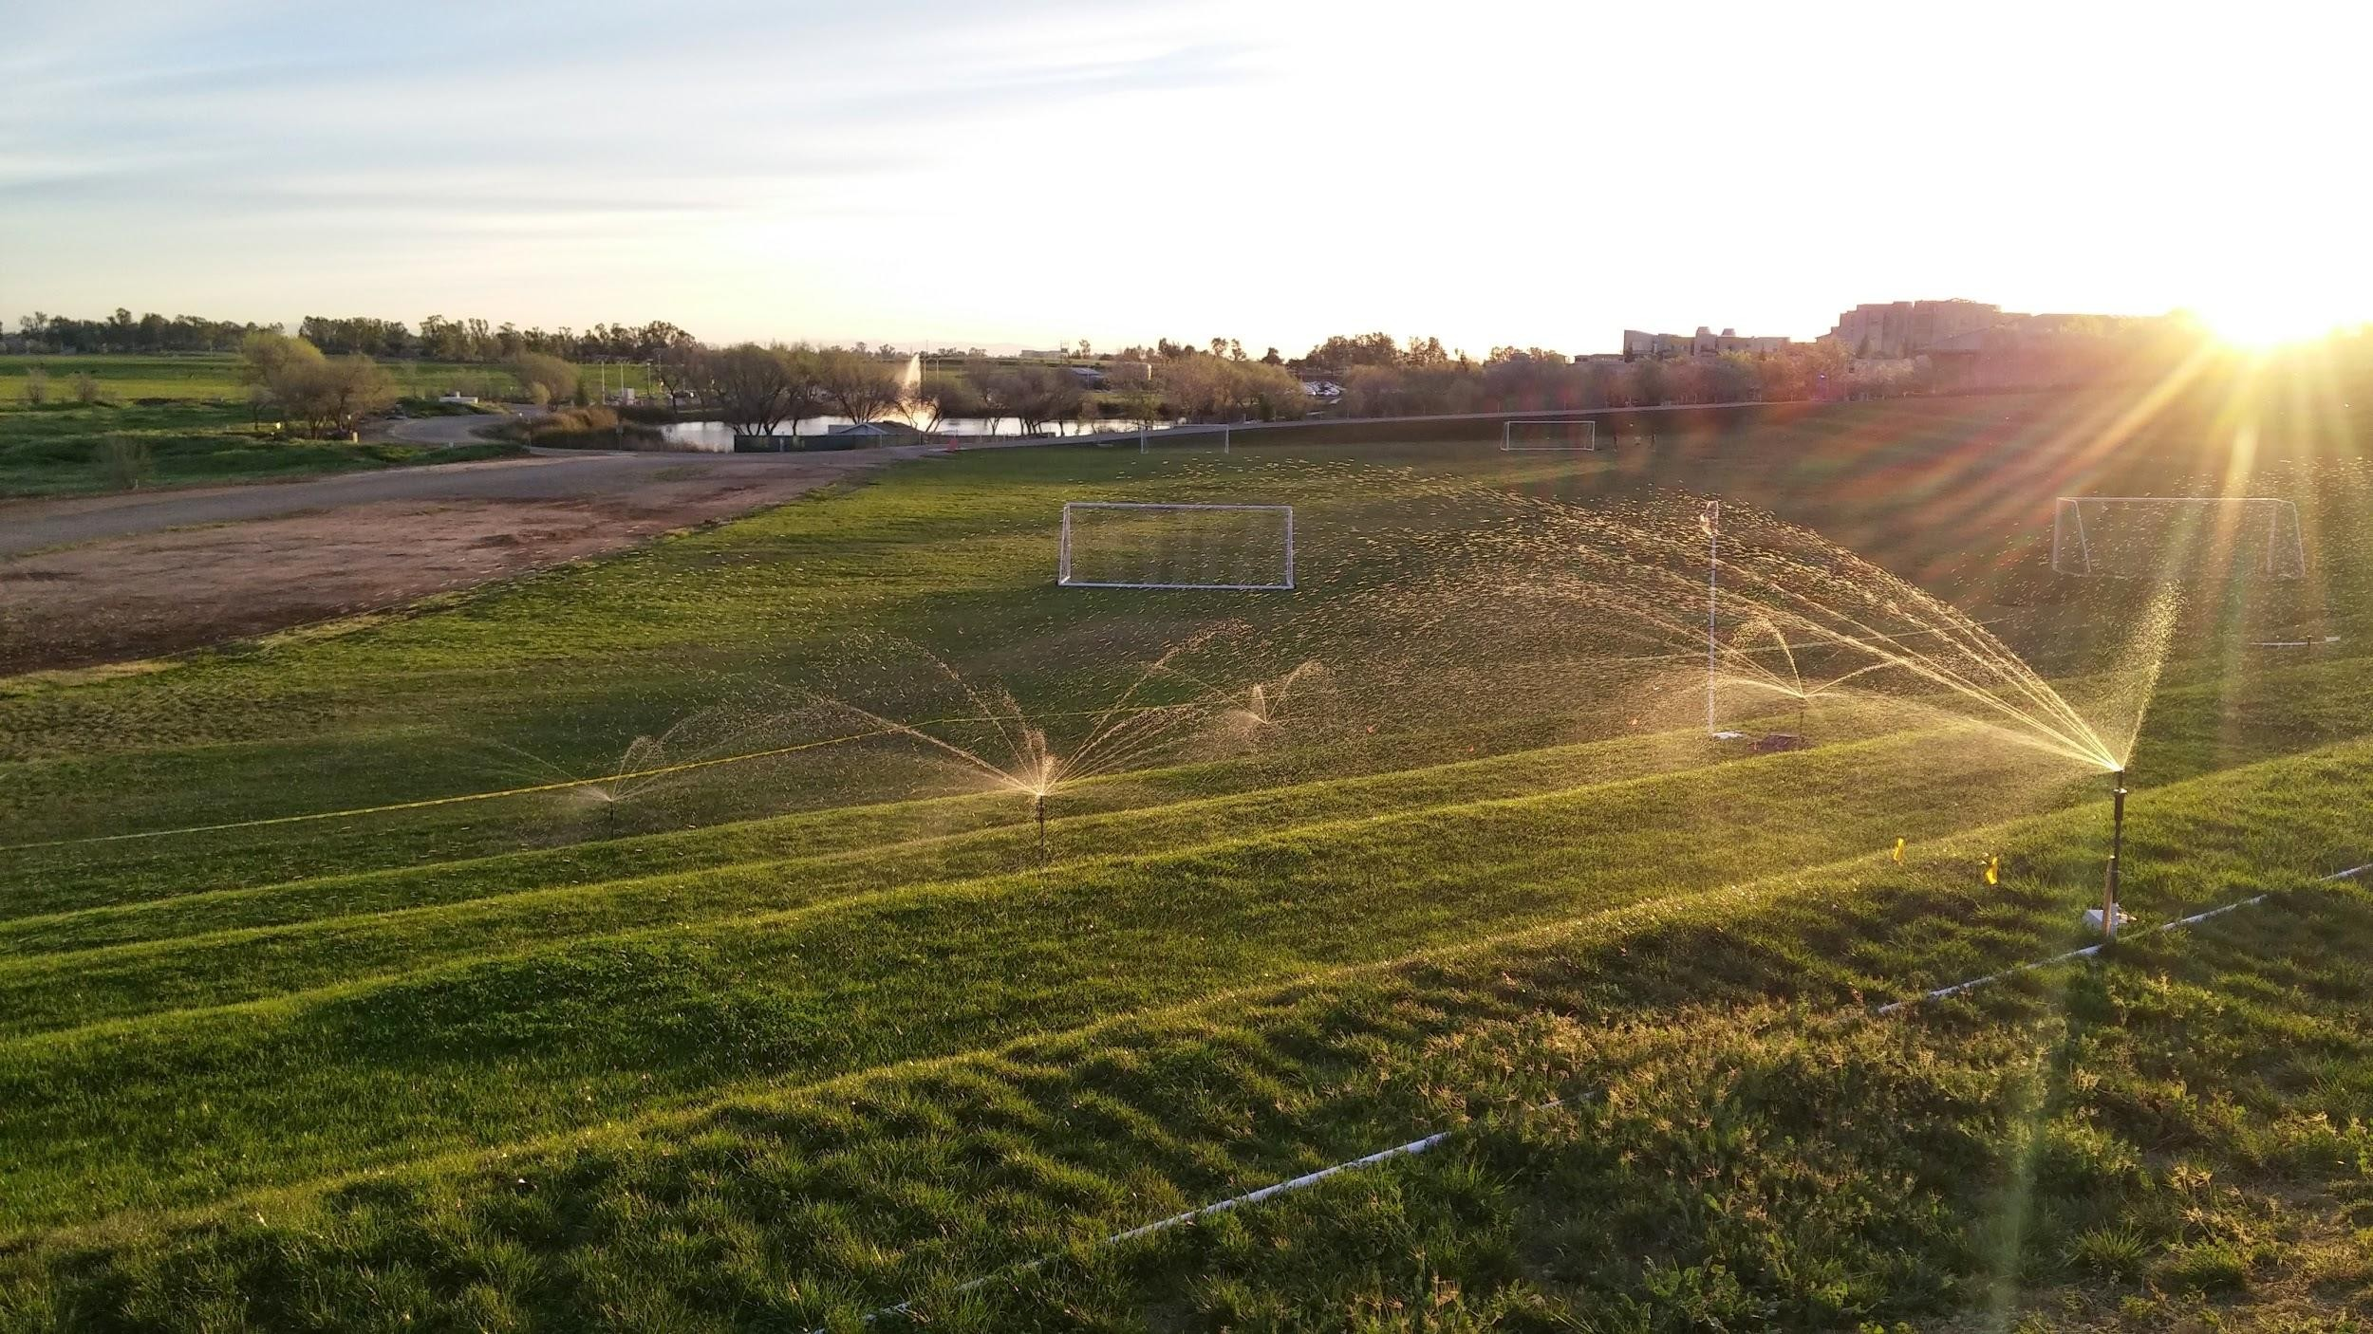
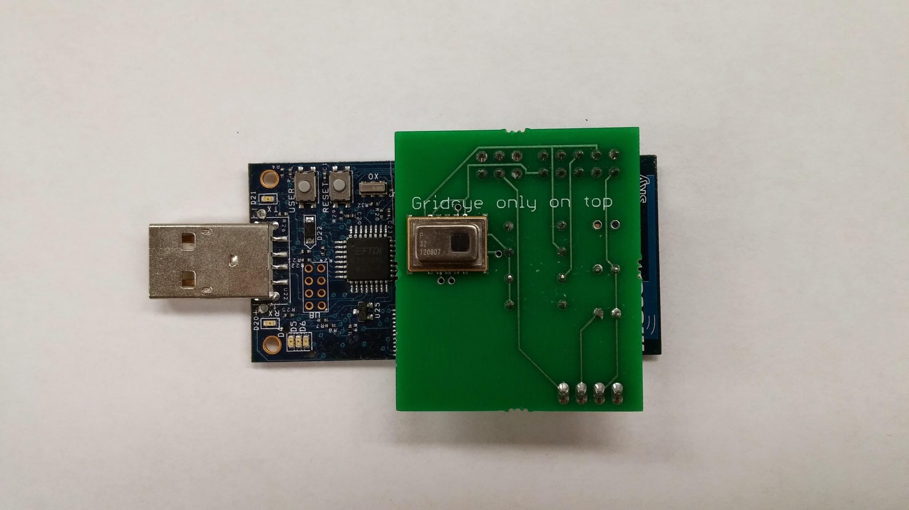
Wireless Sensor Networks
A wireless sensor network (WSN) is a wireless network consisting of spatially distributed autonomous devices using sensors to monitor physical or environmental conditions.

Slide 3
Potential Applications
Environmental monitoring of air, water, and soil
Structural monitoring for buildings and bridges
Industrial machine monitoring
Process monitoring
Asset tracking

Slide 4

TinyOS
Open Source operating system designed for low-power wireless devices
Used in Academia
Components/Interfaces
Event Driven
Mostly Synchronous
Open Source

Slide 5
Why TinyOS?
Traditional OSes are not suitable for networked sensors
Huge !
Multi-threaded architecture =>large memory
I/O model
Kernel and user space separation
Typically no energy constraints
Ample available resources

Slide 6
Sensor Hardware Constraints
Lower Power
Limited memory
Slow CPU
Size (Small)
Limited hardware parallelisms
Communication using radio
Low-bandwidth
Short range

Slide 7
Tiny OS properties
Small memory footprint
Efficient in power and computation
Communication is fundamental
Real-time
Support diverse application design
Concurrency: uses event-driven architecture
Communication
Uses event/command model
FIFO and non pre-emptive scheduling
Modularity
Application composed of components
OS + Application compiles into single executable

Slide 8
Software
TinyOS (Platform)
Coding language
NesC (Network Embedded System C)
Basic unit of nesC code is a component
Components connect via interfaces
Connections called “wiring”
A
B
interface

Slide 9
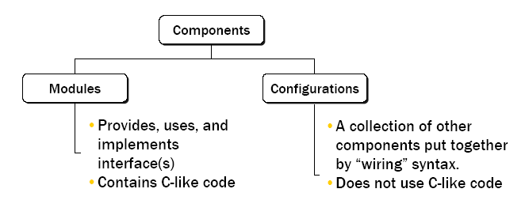
NesC

Slide 10
TOSSIM
Simulates entire tiny OS application
Replaces components with simulation implementation
Core code = tos/lob/tossim
2 interfaces :
C
Python

Slide 11
Project Outlines
Project #0 - Getting Started
Project #1 - Flooding and Neighbor Discovery - 5 %
Project #2 - Routing Table – 17.5 %
Project #3 - Reliable Transport - 25 %
Project #4 - Application Layer – 7.5 %

Slide 12
Words of Advice
This class is tough, so allocate enough time to it
Finish early
Partial Credit is better than no credit
If a project is not fully functional by submission, be sure to catch up quickly.
Use good programming practices
No magic numbers
Descriptive names
Comments

Slide 13
Expectations
This semester, we will be implementing various protocols on top of a TinyOS network emulator and simulator called "TOSSIM".
Get comfortable with programming
Start using linux
C / Python
Docker – (Makes development a breeze) – not related to the course

Slide 14



Project #0 - Virtualization
Docker
Lightweight
Reproducible
Higher learning curve
Vagrant
Lightweight
Reproducible
Virtualbox
Backend to handle the VM
Available on Mac/Windows/Linux
+

Slide 15
Project #0 - Native
Only tested on Ubuntu 14.04 and 16.04
Install the toolchain for compiling nesc and supporting tools for simulation.

Slide 16
Native Installation
Here is a quick way of getting tinyos installed on the lab machines in SE1-100. This has has not been tested on machines outside of the lab and will likely not work on other machines.
Open a terminal and enter the following command to download a bundle of the necessary binaries.
wget http://andes.ucmerced.edu/~abeltran2/cse160/fall2016/lab_tinyos.tar.gz
tar xvfz lab_tinyos.tar.gz
cd bundle
./install.sh
export TINYOS_ROOT_DIR=$HOME/bundle/tinyos-main/
You will need to exit your terminal for the path to be added correctly and start your terminal again.

Slide 17
Installing TinyOS on your PC
Docker – catcourses.ucmerced.edu under files>Lab>TinyOS installation – Docker.pdf
Virtual Machines/Native - catcourses.ucmerced.edu under files>Projects>Project 0 – Getting Started.pdf

Slide 18
Comparison
V irtualization
+ Consistent
+ Persistent
+ Can use IDE using a shared folder
Bad on slow/old computers
Requires to have a separate terminal for building.
N ative
+ Fast
+ Easier to build in an IDE
- Lab machines do not have persistent software

Slide 19
Resources
The official TinyOS Documentation -
http://tinyos.stanford.edu/tinyos-wiki/index.php/TinyOS_Documentation_Wiki
Free Book
http://csl.stanford.edu/~pal/pubs/tos-programming-web.pdf
nesC: http://nescc.sourceforge.net/

